Slide 1


Depression Detection Model using Sentiment Analysis in Micro-blog Social network
DEPARTMENT OF COMPUTER SCIENCE AND ENGINEERING
Under the guidance of
AFSAR BAIG M
ABDULLAH BIN MOHAMMAD IQBAL | 4BP16CS001
SHANKARAGOWDA B | 4BP16CS041
ABDUL TAWWAB MULLA | 4BP17CS001
NASHEEL RAHMAN | 4BP17CS024

Slide 2
Depression Detection Model using Sentiment Analysis in Micro-blog Social network
Every life matters...

Slide 3
Index
01
02
03
Introduction
Objectives
Motivation

Slide 4
Index
04
05
06
Scope
Problem Statement
Literature Survey

Slide 5
Index
07
08
09
Methodology
Implementation
Conclusion and Future scope

Slide 6
Index
10
References

Slide 7
“That's the thing about depression: A human being can survive almost anything, as long as she sees the end in sight. But depression is so insidious, and it compounds daily, that it's impossible to ever see the end.”
Elizabeth Wurtzel, Prozac Nation

Slide 8
01
Introduction
Depression Detection Model using Sentiment Analysis in Micro-blog Social network

Slide 9
INTRODUCTION
Common, serious medical illness
Isolation
Anxiety
Upsurge in Communicaton via Internet
Express feelings

Slide 10
Emotion Detection Techniques
Analyse depression from user’s data
Positive Emotions:
Happy, love, nice, good, pretty
Negative Emotions:
Worthless, loser, hurt, ugly, nasty, bad

Slide 11
Emotion Detection Techniques
Anxiety:
worried, fearful
Sadness:
worry, crying, grief, sad
Anger:
Stop, shit, hate, kill, annoyed

Slide 12
Depression Detection?
Machine Learning Model
Process
Detects or verifies a persons mental image from text in a social networking apps
Compare selected emotions from text and try against model to analyze

Slide 13
02
Objectives
Depression Detection Model using Sentiment Analysis in Micro-blog Social network

Slide 14
Objectives
Effective detection of depression
Use of most influential ML technique

Slide 15
03
Motivation
Depression Detection Model using Sentiment Analysis in Micro-blog Social network

Slide 16
Motivation
Suicide
Unaware
Blame
Self Harm

Slide 17
04
Scope
Depression Detection Model using Sentiment Analysis in Micro-blog Social network

Slide 18
Scope
Identification
Accuracy
1
2
Get treatment in earliest stages
Prediction of state of people by available data
User Content
Usage
Utilize text from social network for data
3
4
Ease in accessing content from network

Slide 19
05
Problem statement
Depression Detection Model using Sentiment Analysis in Micro-blog Social network

Slide 20
Problem Statement
Detection
Effect
Individual
Unable to detect normally
Problematic on a long run
Any one can be checked against

Slide 21
Problem Statement
Analysis
Personality
Individual
Subject-dependent sentiment analysis
Abstract Features
Target Dependent Features are considered

Slide 22
06
Literature Survey
Depression Detection Model using Sentiment Analysis in Micro-blog Social network

Slide 23
Literature Survey
Wang, Xinyu, et al. "A depression detection model based on sentiment analysis in micro-blog social network." Pacific-Asia Conference on Knowledge Discovery and Data Mining. Springer, Berlin, Heidelberg, 2013.
Depression detection in social network via DM
Calculate depression inclination by vocabulary and man-made rules
Constructed based on ten features derived from psychological research

Slide 24
Literature Survey
Wang, Xinyu, Chunhong Zhang, and Li Sun. "An improved model for depression detection in micro-blog social network." 2013 IEEE 13th International Conference on Data Mining Workshops. IEEE, 2013.
Detection based on node and linkage features
Measuring Linkage features: tie strength, interaction content analysis
Propagation rule of depression is considered

Slide 25
Literature Survey
Islam MR, Kabir MA, Ahmed A, Kamal ARM, Wang H, Ulhaq A. Depression detection from social network data using machine learning techniques. Health Inf Sci Syst. 2018;6(1):8. Published 2018 Aug 27. doi:10.1007/s13755-018-0046-0
Depression analysis on Facebook data
Propose ML technique
Evaluation of efficiency of proposed method using psycholinguistic features

Slide 26
Literature Survey
Song, Hoyun, et al. "Feature Attention Network: Interpretable Depression Detection from Social Media." Proceedings of the 32nd Pacific Asia Conference on Language, Information and Computation. 2018.
Propose Feature Attention Network (FAN)
FAN: process of diagnosing depression by an expert who has background knowledge about depression
Evaluate the performance of model on a large-scale general forum (Reddit Self-reported Depression Diagnosis) dataset

Slide 27
07
Methodology
Depression Detection Model using Sentiment Analysis in Micro-blog Social network

Slide 28
Methodology
Emotional Process
Temporal Process
Linguistic style
All Features

Slide 29
Methodology
Data set Exploration
Data set preparation
Building ground truth dataset
Collect data from social network
Text Analysis by processing line by line
Depression Indicative content (Y/N)

Slide 30
Methodology Feature Extraction
Psychological process
Time orientations
Perceptual processes
Linguistic process
Personal Concerns
Refer people: Present, Past, Future
See, Hear, Feel
Recognize connection between people

Slide 31
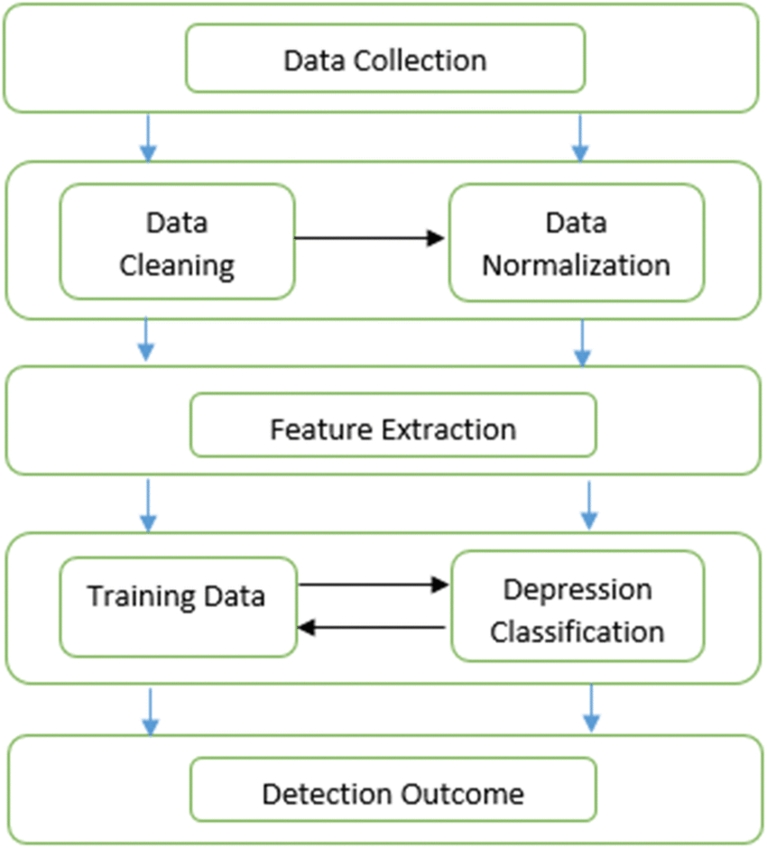
Methodology

Slide 32
08
Implementation
Depression Detection Model using Sentiment Analysis in Micro-blog Social network

Slide 33
Implementation
 | NumPy
 | Pandas
 | Sklearn
 | Seaborn

Slide 34
09
Conclusion and Future Scope
Depression Detection Model using Sentiment Analysis in Micro-blog Social network

Slide 35
Conclusion
Model Detects Depressed users in a social network based on sentiment Analysis
Saves time and effort, in case of a psychologist with huge number of patients
Accuracy of a model is around 65 percentage by heeding all categories

Slide 36
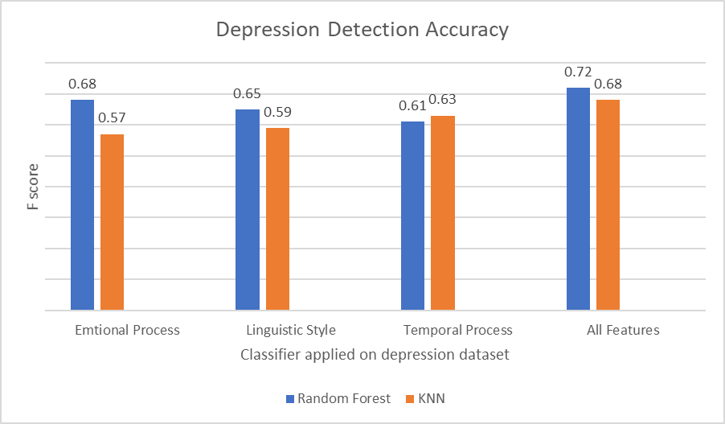

Slide 37
10
References
Depression Detection Model using Sentiment Analysis in Micro-blog Social network

Slide 38
References
Wang, Xinyu, et al. "A depression detection model based on sentiment analysis in micro-blog social network." Pacific-Asia Conference on Knowledge Discovery and Data Mining. Springer, Berlin, Heidelberg, 2013.
Wang, Xinyu, Chunhong Zhang, and Li Sun. "An improved model for depression detection in micro-blog social network." 2013 IEEE 13th International Conference on Data Mining Workshops. IEEE, 2013.

Slide 39
References
Islam MR, Kabir MA, Ahmed A, Kamal ARM, Wang H, Ulhaq A. “Depression detection from social network data using machine learning techniques”. Health Inf Sci Syst.2018;6(1):8. Published 2018 Aug 27.doi:10.1007/s13755-018-0046-0
Song, Hoyun, et al. "Feature Attention Network: Interpretable Depression Detection from Social Media." Proceedings of the 32nd Pacific Asia Conference on Language, Information and Computation. 2018.

Slide 40

THANK YOU

